Slide 1
GLOBAL NEAR-REAL-TIME INTERDISCIPLINARY
GEOSPATIAL DATA DEVELOPMENT,
ANALYSIS, ARCHIVING, SUSTAINABILITY,
ACCESSIBILITY, DISSEMINATION, COLLABORATIVE RESEARCH
AND INCLUSIVE WORKFORCE DEVELOPMENT
National Science Foundation Sponsored Geospatial Software Institute SESYNC/UMD Workshop - Annapolis, MD, July 14-16, 2019
Gilbert Rochon, PhD, MPH, Adjunct Professor, Department of Health Management & Policy
Tulane University School of Public Health & Tropical Medicine
Senior Consultant, MSF Global Solutions, LLC
Co-Chair, Higher Education Initiative, African Renaissance & Diaspora Network (ARDN)

Slide 2
Outline
Establishing Linkages to Archival and Real-Time Satellite Data
Enabling Access to Multi-Country Earth Observing Satellite Data
Facilitating Disaster Life Cycle Resilience
Engaging with Remote Sensing Consortia
Serving as the Hub for Global Geospatial Data Ingestion, Analysis & Dissemination
Committing to Geospatial Workforce Sustainability and Diversity
Initiating Workforce Development Pipeline Programs
Attenuating the Geospatial Digital Divide
Integrating Diverse Sources of Geospatial Data
Promoting Collaborative Research on Spectral Analysis at Multiple Scales

Slide 3
Linkages to Archival & Real-Time Satellite Data
As the Hub for Access to and Analysis of Geospatial Data for Interdisciplinary Collaborative Research and Applications, GSI could serve a vital role in facilitating optimal utilization of Archival Satellite Data, as well as Real-Time Earth Observing Data from multiple sources, in support of time-critical initiatives.

Slide 4
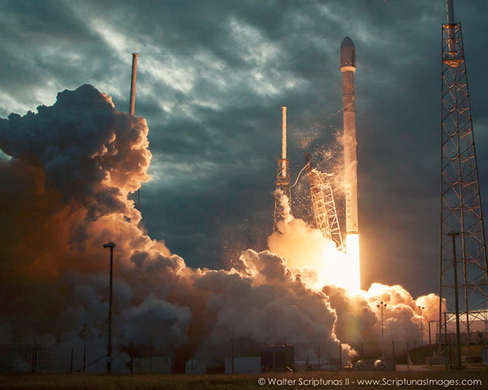
Facilitating Access to Multi-Country
Earth Observing Satellite Data
European Space Agency
SPOT (France)
ALMAZ, KVR, KATE, METEOR, GLONAS (Russia)
ALOS, ADEOS, JERS, ASTER (Japan)
IRS 1B, 1C, P3, P4; ResouceSat, CartoSat, InSat (India)
Feng Yun (China)
KITSAT, KOMSAT I & II (S. Korea)
Disaster Constellation
  (Nigeria, Tunisia, Algeria, UK)
SunSat (South Africa)
TurkSat 4B (Turkey)
BisonSat (Salish Kootenai
College) Oct. 8, 2015
Morelos 3 (Mexico) - Disaster
Relief Communications – 2015
2013: 81 SPACE LAUNCH ATTEMPTS
2014: 92 SPACE LAUNCHES; 90 MISSIONS REACHED ORBIT
SPACEX FALCON 9 – JAN. 2014
CHINA IN 2015:
  YAOGAN 28
  ChinaSat 2C
  TIANHUI 1-03
  LINGQIAO

Slide 5
Remote Sensing Diversity:
PRISMA (Italy) 2019
Sac-C (Argentina) CONAE
EURASIASAT-1 (Turkey) Tubitak
CBERS (Chinese Brazilian Earth Resource Satellite) (Brazil & China) INPE & CSA
Feng Yun; Gaofen-11 2018 (China) CNSA
EROS (Israel) ISA (Res. 1.8m; 480 km orbit, 3-7 day revisit, depending upon latitude)
NigeriaSat I (Nigeria) NigeriaSat II (2006-Nigeria & South Africa)
Zarca Elyamama (2007- Morocco)
MSMI (Multi-sensor Microsatellite Imager) (2006-Belgium & South Africa) The three types of detectors are:
1. A line scan multispectral detector with better than 5 meter spatial resolution and at least 3 bands: green, red and near-infrared, compatible to SPOT 4 bands.
2. A hyperspectral detector with better than 15 meters spatial resolution and more than 200 spectral bands, ranging from 400 nanometers to 2.35 micrometers.
3. A matrix continuous video detector with better than 10meters spatial resolution.
LAPAN A-2 Indonesian Micro-Satellite launched Sept. 28, 2015
ASTROSAT - Indian astronomical observatory to study black holes and neutron stars. Sept. 28, 2015

Slide 6
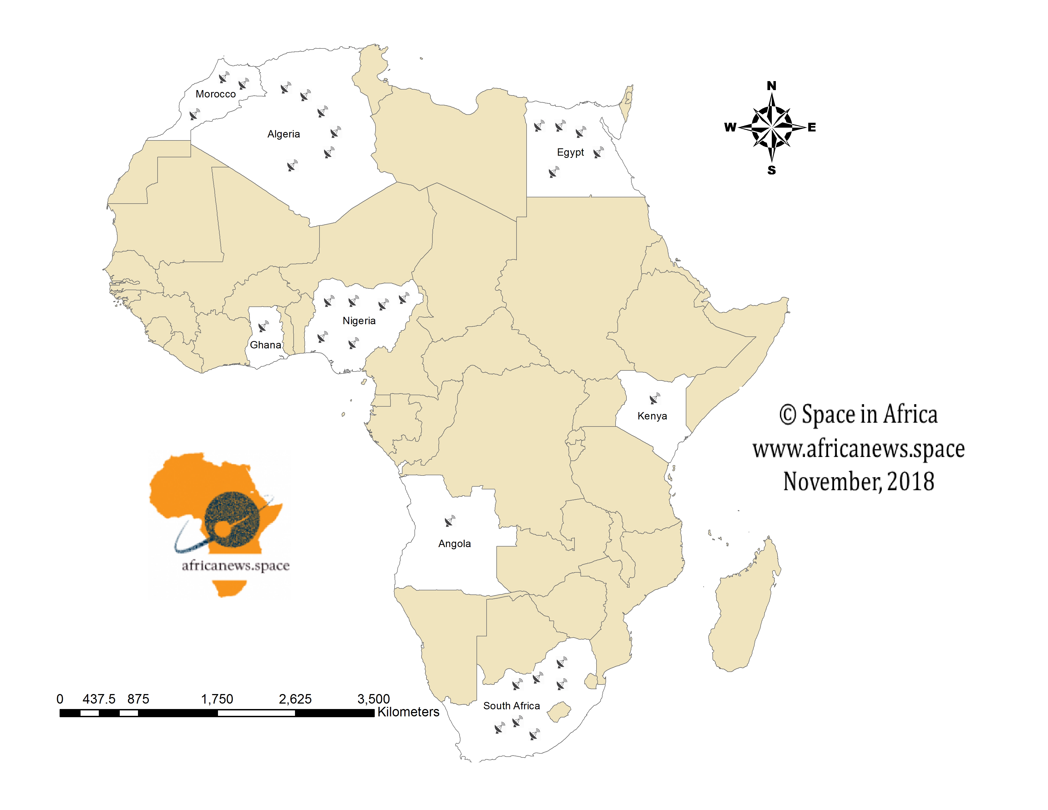
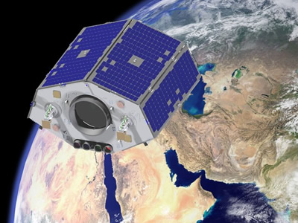
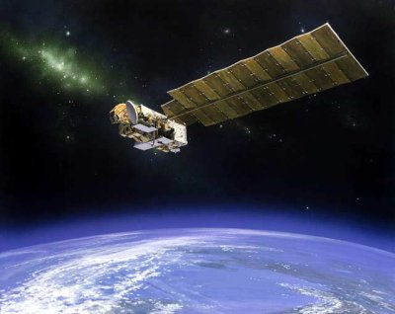

African Satellites
NigeriaSat 2 (Disaster Monitoring & Security)
NigeriaSat X (Aug. 2011)
South Africa: Plans to develop satellite launch
capabilities over the next 10-15 years for
low-cost launch capacity. Previous South African
Satellites – SunSat & Sumbandilasat.
NileSat – Egypt

Slide 7
Disaster Life Cycle Resilience
United Nations International Disaster Charter: Space & Major Disasters
https://disasterscharter.org/web/guest/home;jsessionid=4BE3CA4984719B6789FB3719770C02CE.jvm1 Provides pro bono geospatial data to officially designated major biogenic and anthropogenic disasters from a wide array of governmental and private sector satellite data providers to support disaster monitoring & response, such as search and rescue, etc.
Remaining Pre & Post “Charter Activation” needs that could be addressed by GSI:
  Capacity building to support the entire disaster cycle, i.e.
    Requisite Geospatial technology and staff training In Advance of any such declared disaster:
      Disaster Vulnerability Assessment
      Disaster Resilience Initiatives
      Disaster Preparedness
      Disaster Early Warning
    Ex Post Facto Geospatial Intervention Support:
      Damage Assessment
      Resettlement of Persons Displaced by Disasters
      Structural & Infrastructural Reconstruction
      Societal, Cultural & Economic Reclamation

Slide 8
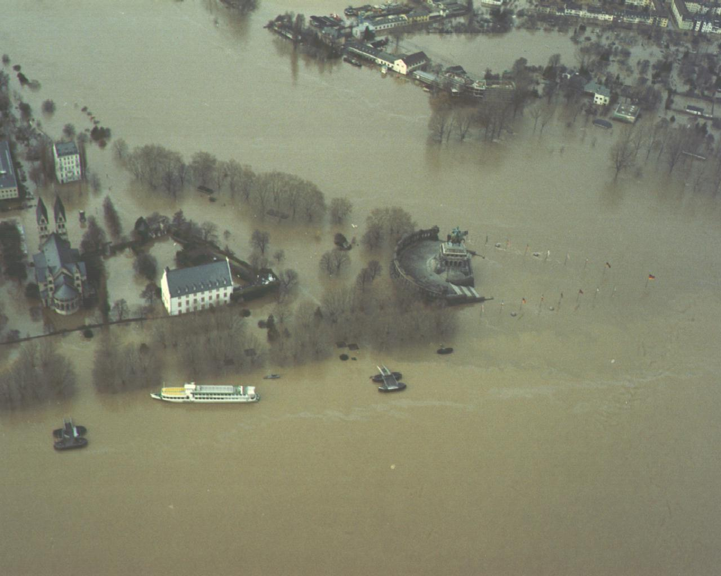
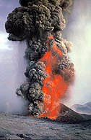
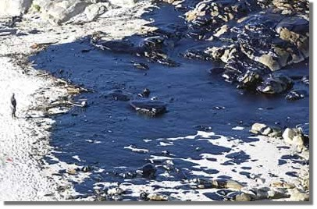
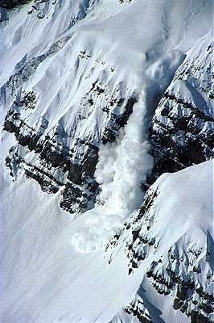
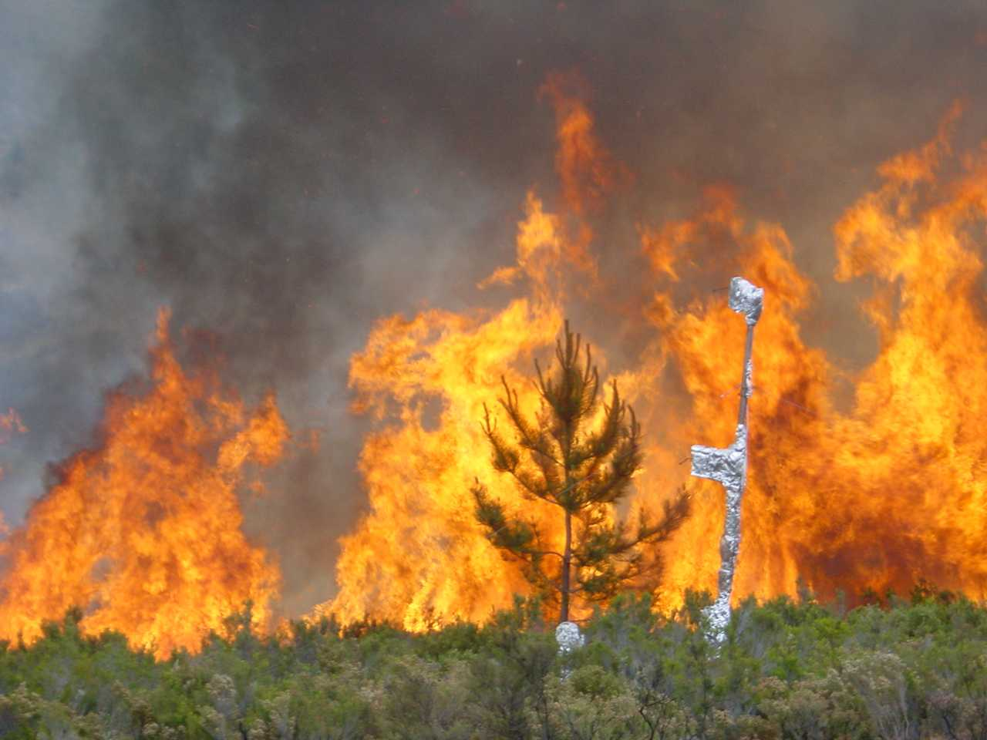
Disasters: Biogenic & Anthropogenic
Notes:
Disasters during the last Decade
Floods in Germany, Austria,Czech Republik, Poland, England, France, Italy, UK;
Earthquakes in Greece and Turkey;
Storms in France, Germany, Austria, Northern Europe;
Forest Fires in the Mediterranean region;
Marine oil tanker accidents (e.g. Erika, Prestige);
Technological disasters (e.g. explosions in Enschede and Toulouse, Danube pollution with Cyanid, Fires in tunnels, Train accidents …)

Slide 9
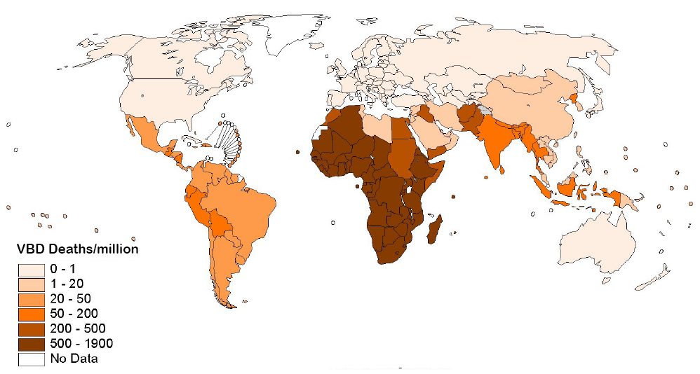
Deaths from Vector-borne Disease
Source : www.WHO.int

Slide 10
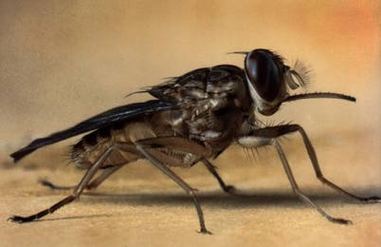
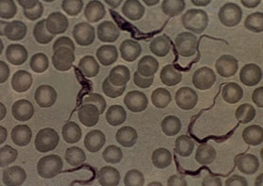
Trypanosomiasis
Tsetse fly (Bantu Name) Glossina morsitans
Trypanosoma brucei
Rogers, DJ & S. Randolph. “Monitoring Trypanosomiasis in Space & Time.” Parasitology. 1993; 351:739-741.

Slide 11
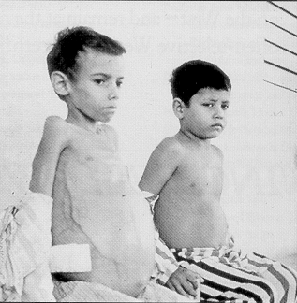

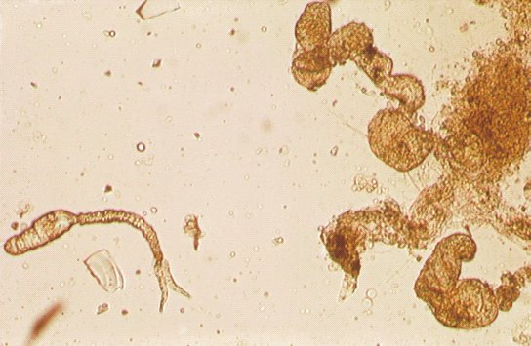
Schistosomiasis(Bilharzia)
Biomphylaria pfeifferi, B. tenagophila, B. glabrata, B. straminea & Bulinus truncatus
Schistosoma mansoni, S. haematobium, S. japonicum,
S. intercolatum
Source: Third
World
Medical
Research
Foundation>

Slide 12
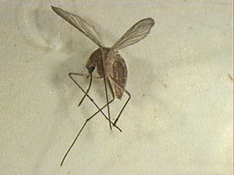
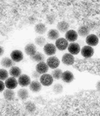
Rift Valley Fever
Culex pipiens & Aedes
RVF Virus
Linthicum, KJ, et al. (1999) Climate & Satellite indicators to forecast Rift Valley Fever epidemics in Kenya. Science 285, 397-4000.

Slide 13
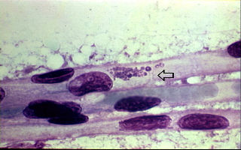

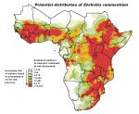

Heartwater (Cowdriosis)
Cowdria ruminantium transmitted by
ticks: Amblyomma
Symptoms: fever,
hydropericardium,
edema of lungs
high mortality

Slide 14
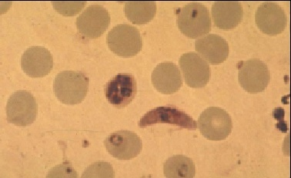
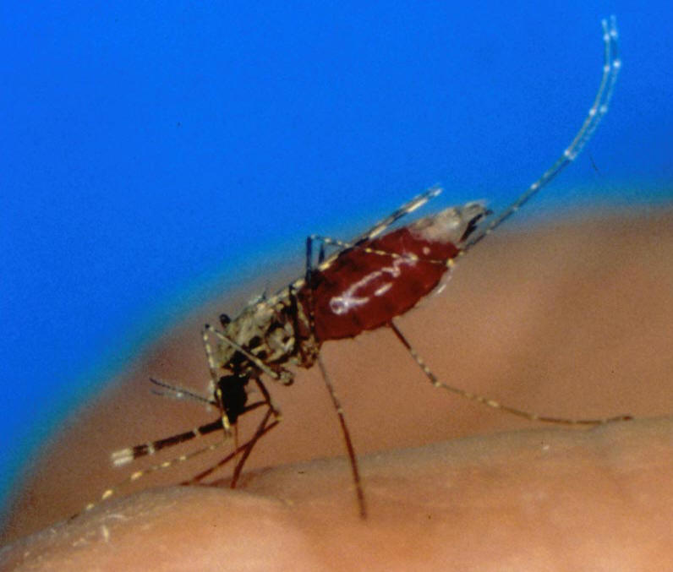
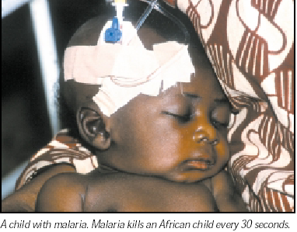
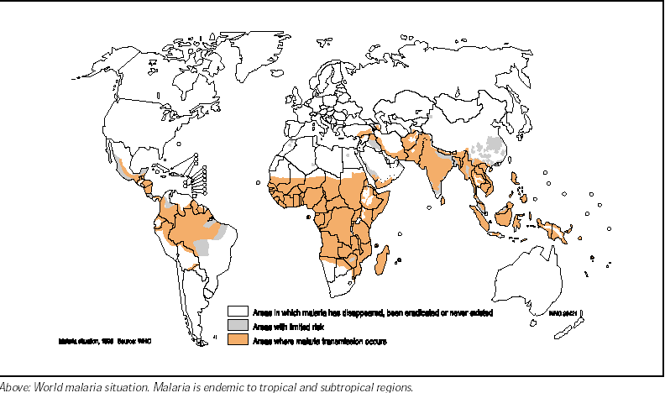
MALARIA - Plasmodium falciparum:
Female Anopheles gambiae Mosquito

Slide 15
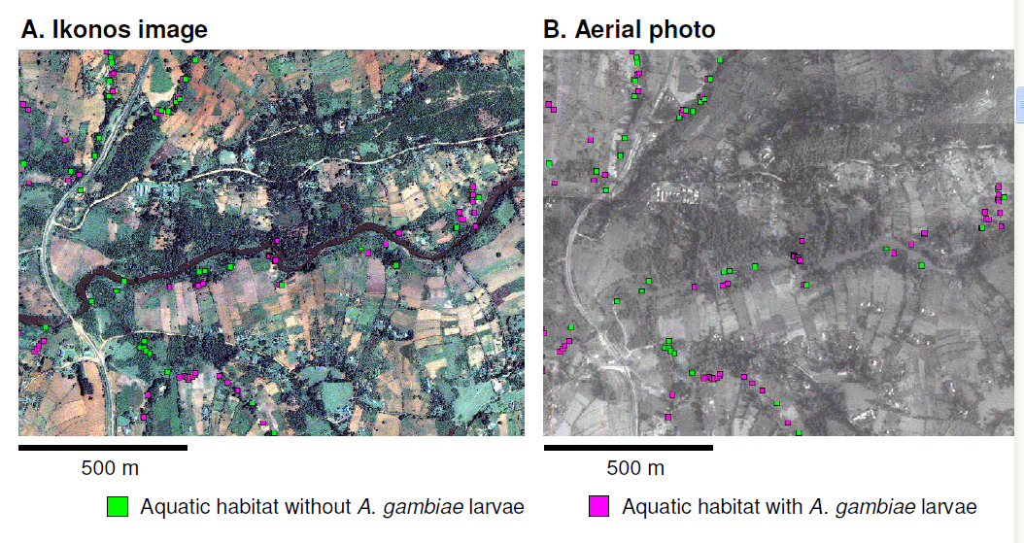
Earth Observing satellites for Malaria Studies
Ikonos image (A) and panchromatic aerial photos (B) showing potential gambiae larvae habitat. (Mushinzimana et. Al, 2006)

Slide 16
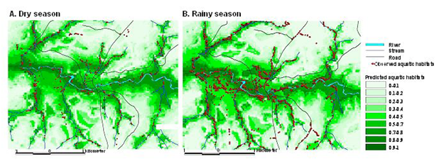
Use of EO for Identifying Aquatic Habitat of Anopheline Mosquitoes
Predicted spatial distribution of aquatic habitats of anopheline mosquito during dry season (A) and rainy season (B) . (Mushinzimana et al., 2006)
.

Slide 17
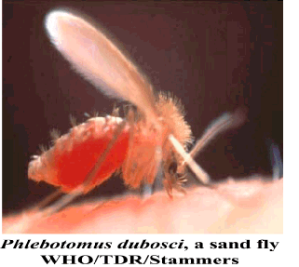

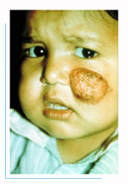
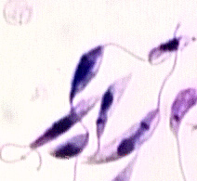
Leishmaniasis
Phlebotomus papatasi,
P. dubosci
Leishmania

Slide 18


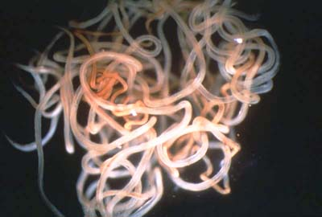
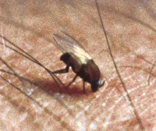
Onchocerciasis
Ivermectin (Merck & Co.), a treatment for onchocerciasis (150 mg/kg single dose) for microfilaria. Alternative: diethylcarbamazine (DEC) & Suramin (macrofilia)
Temephos & clorphoxim insecticides resistance
Adult worms life expectancy: 10-15 years
Onchocerca volvulus

Slide 19
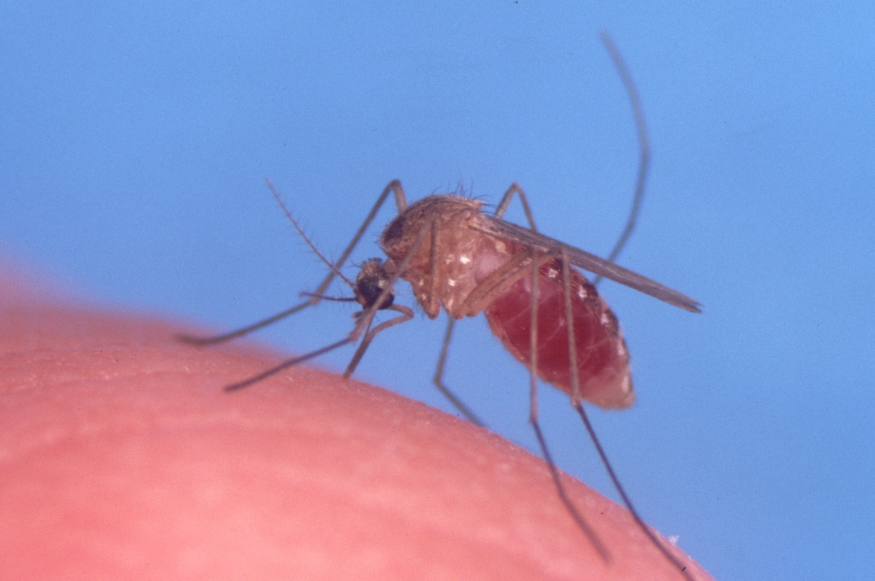

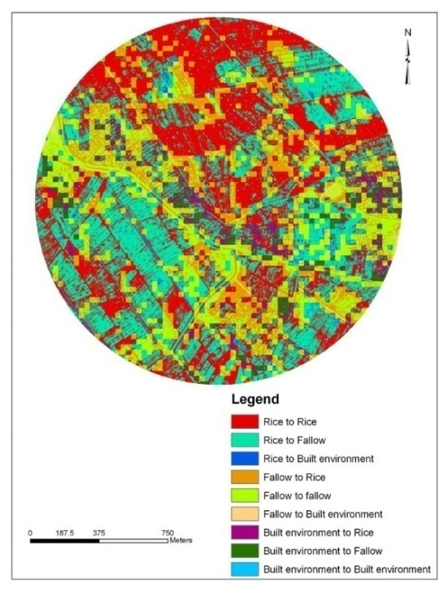
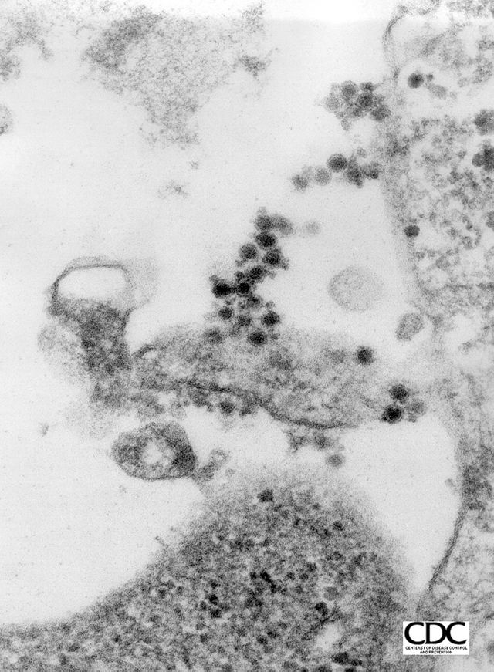
West Nile Virus
Encephalitis
Culex pipiens quinquefaciatus>>>>>
Benjamin G Jacob, et al.“Spatially targeting Culex
quinquefasciatus aquatic habitats on modified land
cover for implementing an Integrated Vector
Management (IVM) program in three villages within the Mwea
Rice Scheme, Kenya,” International Journal of Health Geographics,
2006, Vol. 5, No. 18, May, 2006.

Slide 20
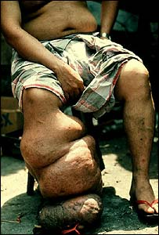
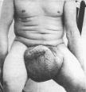



Elephantiasis (Lymphatic Filariasis, Lymphedema, Wuchereria bancrofti Infection, Brugia malayi Infection, Brugia timori Infection, Loa loa Infection)
Elephantiasis is a parasitic disease which is transmitted from human to human by
mosquito Aedes aegypti and other vector bites. The parasite tends to lodge in and block
the lymph nodes that drain into the lower extremities, producing massive enlargement
and deformity of the legs and genitalia

Slide 21
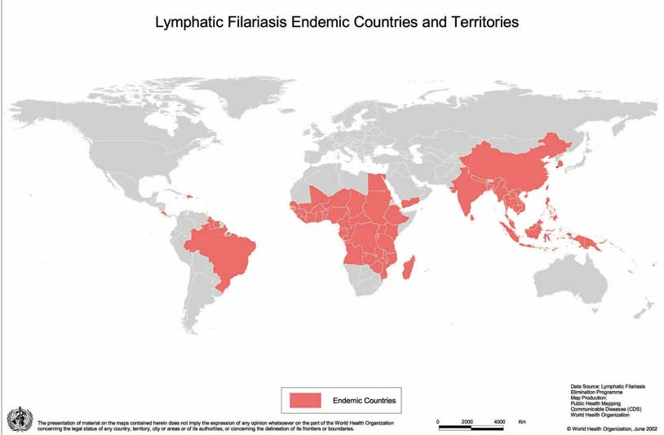

Slide 22

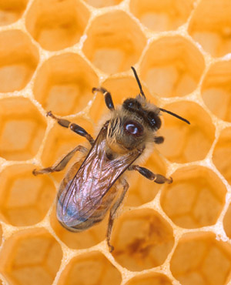
Sustainable Vector Habitat Mitigation:
Protecting Ecosystems & Benign Species
Apis mellifera Linnaeus
Source: U. of Otago, NZ
Crane Fly (Nephrotoma ferruginea)
Photo by: Thomas Shahan, 2009
Source: Today MSNBC.COM

Slide 23
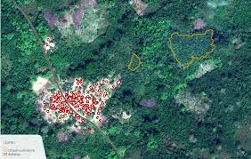
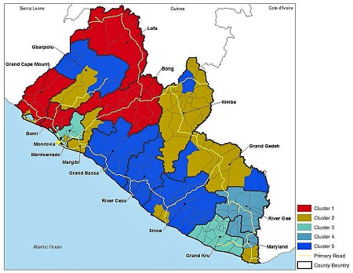
EBOLA
Sentinel-2 MONITORING POTENTIAL EBOLA LOCATIONS FROM SPACE
Copernicus_Factsheets_Ebola_Issue47_October2014.pdf
<< Ebola Virus Disease in Liberia
Expanding the use of social vulnerability assessments to identify hotspots for disease risk
by Zoё Hoyle, SRS Science Delivery Posted on September 15, 2015 by Zoe Hoyle
http://www.srs.fs.usda.gov/compass/2015/09/15/ebola-virus-disease-in-liberia/

Slide 24
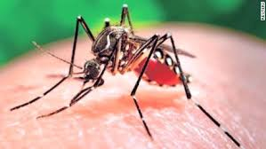
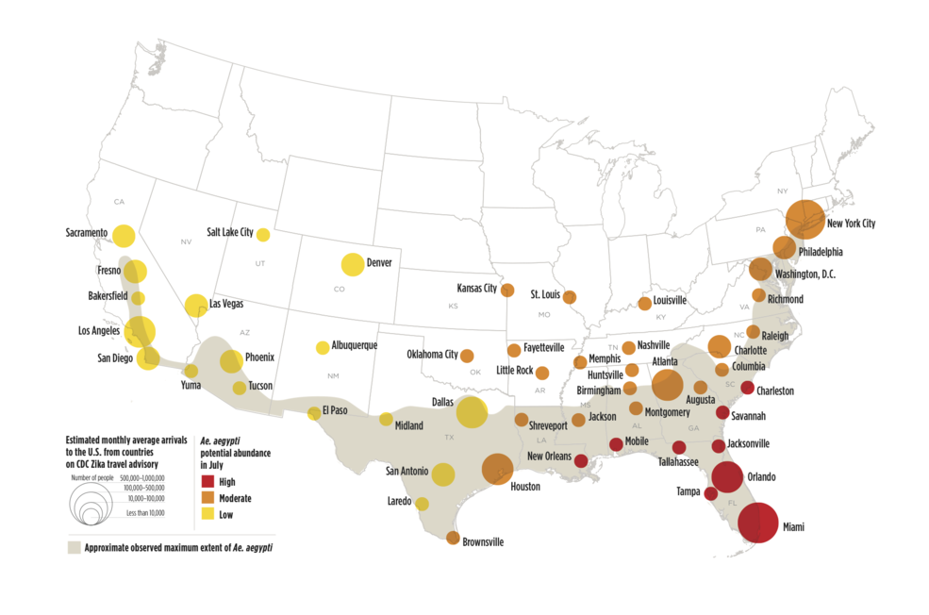
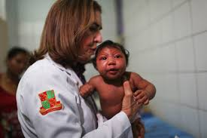
ZIKA VIRUS
April 27, 2016 - NASA Helps Forecast Zika Risk
A risk-assessment map shows Aedes aegypti potential abundance for July.
A risk-assessment map shows Aedes aegypti potential abundance for July and the monthly average number arrivals to the U.S. by air and land from countries on the Center for Disease Control Zika travel advisory. Red dots represent areas with potentially high abundance, while yellow dots represent potentially low abundance areas. Shaded regions represent the approximate maximum range of Aedes aegypti. Credits: UCAR
ESRI: “GIS Technology Proves Fundamental in Battle against Zika Virus” – Aug. 10, 2016 http://www.esri.com/esri-news/releases/16-3qtr/gis-technology-proves-fundamental-in-battle-against-zika-virus
Source: IBI Times - UK

Slide 25
Remote Sensing Consortia & Assoc. Engagement
African Association for Remote Sensing of the Environment (AARSE)
USGS sponsored AmericaView
Consortium for Advancement of Remote Sensing (CFARS)
National Consortium on Remote Sensing in Transportation (NCRST)
American Society for Photogrammetry & Remote Sensing (ASPRS)
International Society for Photogrammetry & Remote Sensing (ISPRS)
Aerial Cartographic & Remote Sensing Association (ACRSA)
IEEE Geoscience & Remote Sensing Society (GRSS)
American Association of Geographers (AAG)
European Association of Remote Sensing Companies (EARSC)
Space Research & Remote Sensing Organization (SPARRSO)-Bangladesh
International Society for Optics & Photonics (SPIE)
National Authority for Remote Sensing & Space Sciences (NARSS) – Egypt
Indian Space Research Organization (ISRO)

Slide 26
Hub for Global interdisciplinary Geospatial Data Ingestion, Analysis & Dissemination
Multi-Lingual User Interface
Linkages with Multi-Lateral Agencies, e.g.
  WHO
  PAHO
  UNEP
  UNDRO
  UNHCR
  UNOOSA
  SPIDER (UN Platform for Space-Based Information for Disaster Management and Emergency Response)
  NATO Science for Peace
  United Nations University (UNU) Institutes
  Organization of American States (OAS)
  UNAIDS
  African Union (AU)
  European Union (EU)
  REDLAD (The Latin American and Caribbean Network for Democracy)
  Afrocolombian Global Initiative
  Association of Southeast Asian Nations (ASEAN)

Slide 27
Geospatial Workforce Sustainability & Diversity
Development of Partnerships with Associations Representing Collectivities of Institutions of Higher Learning Representing Diverse Populations, e.g.:
  NAFEO (National Association for Equal Opportunity in Higher Education),
  APLU’s (Association of Public & Landgrant Universities’) Council of 1890 Universities
  UNCF (United Negro College Fund)
  Thurgood Marshall Scholarship Fund
  HACU (Hispanic Association of Colleges & Universities)
  AIHEC (American Indian Higher Education Consortium)
  Women’s College Coalition (WCC)
  ARUA (African Research Universities Alliance)
  AAU (Association of African Universities)
  AANAPISI (Asian American and Native American Pacific Islander-Serving Institutions)
  UNICA (Association of Caribbean Universities and Research Institutes)
  UDUAL (Association of Universities of Latin America and the Caribbean)

Slide 28
Geospatial WorkforcE career Pipeline Program
Con-current Collegiate Enrollment for Advance Placement High School Seniors
Undergraduate Geospatial Research Opportunities
Intensive Summer Geospatial Software Training & Application Programs
Graduate Student Research Assistantships in Geospatial Software
Grants for Masters Thesis & Doctoral Dissertations
Mutual Study Abroad Opportunities in Geospatial Software Science & Technology
Support for Student Conference Participation, Presentations & Competitions
Post-Doctoral GSI Fellowships & Incentivized Faculty Exchange
Facilitation for Publication in Selected Peer Reviewed Publications
Early Career/Young Investigator Awards
GSI Faculty Fellows Program
GSI Endowed Professorships

Slide 29
Attenuating the Digital Divide
Development &/or Distribution of Geospatial Freeware (e.g. Purdue U.’s MultiSpec)
Capacity Building for Multi-Spectral & Hyper-Spectral Data Analysis
Cyber-Infrastructure Enhancement
Facilitation of Access to Supercomputing & High Performance Computing Networks e.g.
  NCSA
  Purdue
  Texas
  Pittsburgh
  San Diego
  Oregon
  Clemson
  Arctic Region Supercomputing Center – U. of Alaska Fairbanks
  Mare Nostrum – Barcelona
  CHPC – Center for High Performance Computing – Cape Town, South Africa
Global Expansion of Collaborative Models e.g. DOD HPCMO PET; USGS AmericaView

Slide 30
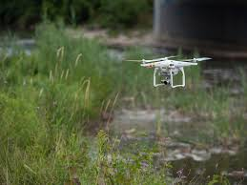
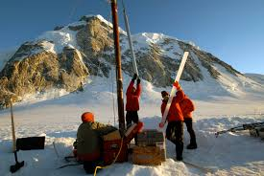
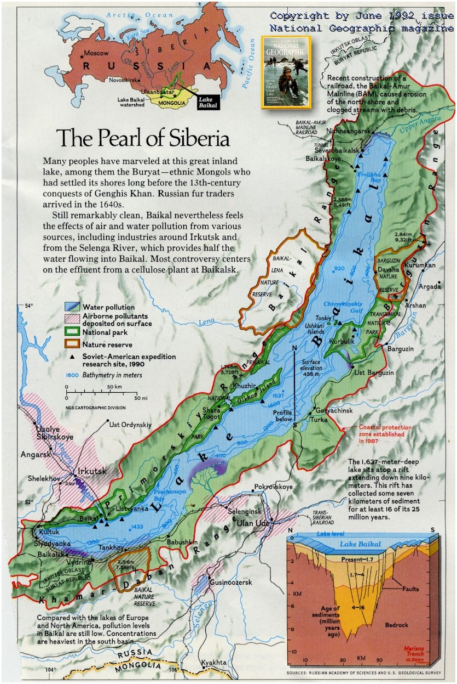
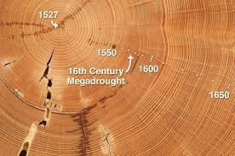
Integrating Diverse Sources of Geospatial Data
Eos.org
Irkutsk.org
UAVs
In Situ Meteorological, Temperature, Seismological & Atmospheric Monitoring Stations
Polar Ice Coring Data
Limnological Core Data
Dendrochronology Data
Geological Data
Archaeological Data
Paleontology Data
NSF Ice Core Facility – icecores.org
Earthsci.org

Slide 31
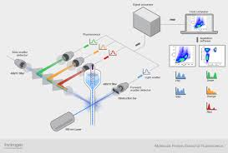
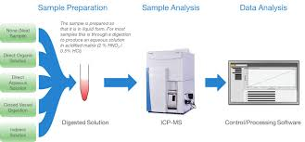
Collaborative Spectral Analysis Research at Multiple Scales
Flow Cytometry
Atomic Force Microscopy
Laser Rahman Spectroscopy
High Performance Liquid Chromatography
X-Ray Florescence
Inductively Coupled Plasma
Source: Thermofisher.com

Slide 32
references
Thierno Thiam & Gilbert Rochon, Sustainability, Emerging Technologies & Pan-Africanism. London: Palgrave Macmillan, In Production, 2019.
John B. Malone, Robert Bergquist, Moara Martins and Jeffrey C. Luvall. “Use of Geospatial Surveillance and Response Systems for Vector-Borne Diseases in the Elimination Phase, “Trop. Med. Infect. Dis. 2019, 4(1), 15; https://doi.org/10.3390/tropicalmed4010015
Shaowen Wang, Michael F. Goodchild. CyberGIS for Transforming Geospatial Discovery and Innovation, Springer, Dordrecht, First Online 27 June 2018. On Line ISBN 978-94-024-1531-5 https://link.springer.com/chapter/10.1007/978-94-024-1531-5_1

Slide 33
references
Alvaro Uyaguari, Edison Espinosa-Gallardo Santiago P. Jácome-Guerrero Patricio Espinel Cristian F. Cabezas Gloria I. Arias Almeida Frankz Alberto Carrera Calderón. Open Source Web Software Architecture Components for Geographic Information Systems in the Last 5 Years: A Systematic Mapping Study. Advances in Intelligent Systems and Computing book series (AISC, volume 721). January 05, 2018. https://link.springer.com/chapter/10.1007/978-3-319-73450-7_65
Ramgopal Kashyap. Geospatial Big Data, Analytics and IoT: Challenges, Applications and Potential. Studies in Big Data book series (SBD, volume 49) Springer, Cham 11 Dec., 2018 https://link.springer.com/chapter/10.1007/978-3-030-03359-0_9#citeas
Jason Matney, “Remote Sensing & Cyber GIS: Performing Uncertainty and Classification Assessment with a Supercomputer Optimized for Geospatial Parallel Processing,” Harvard University Center for Geographic Analysis, Jan. 9, 2019, Cambridge, MA.

Slide 34
references
Chaker El Amrani, Mohamed Akram Zaytar, Gilbert L. Rochon, Tarek El-Ghazawi, “Processing EUMETSAT Big Datasets to Monitor Air Pollution,” European Geosciences Union Conference (EGU 2018), Vienna, Austria, April 8-13, 2018.
Gilbert Rochon, Marseyas Fernandez, Thierno Thiam, Joseph Essamuah-Quansah, Souleymane Fall, Gamal Salah El Afandi, Chaker El Amrani, Tajje-eddine Rachidi, Subhas Sikdar, Gülay Altay, Tarek El-Ghazawi, Mohamed Magdy Abdel Wahab, Nosa Egiebor and Chadia Affane Aji. “Toward Pan-African Disaster Resilience: Potential Collaborative Extension of the Mediterranean Dialogue Earth Observatory (MDEO) Model to Support Biogenic and Anthropogenic Disaster Resilience, Early Warning, Mitigation and Recovery for Vulnerable Populations within the African Continent and in the African Diaspora,” presented at the 11th International Conference of the African Association for Remote Sensing of Environment (AARSE). Kampala, Uganda, October 24-28, 2016.

Slide 35
references
Product News: ”BD Debuts New Software for Flow Cytometry Analysis,” June 20, 2019. “FlowJo™ software version 10.6 adds new features and integration with BD FACSDiva™ software,” https://www.selectscience.net/product-news/bd-debuts-new-software-for-flow-cytometry-analysis?artID=49239
Chaker El Amrani, Gilbert L. Rochon, Tarek El-Ghazawi, Joe Piskor, Gülay Altay, Tajje-eddine Rachidi. “MDEO System for Environmental Monitoring in Morocco,” NASA Direct Readout Conference (NDRC-9), Valladolid, Spain, June 21-24, 2016.
C. El Amrani, G.L. Rochon, T. El Ghazawi, G. Altay, T. Rachidi, “System Architecture of the Mediterranean Dialogue Earth Observatory,” IEEE International Geoscience and Remote Sensing Symposium (IGARSS), Melbourne, Australia, 2126, July, 2013. Digital Object Identifier: 10.1109/IGARSS.2013.6721228 Publication Year: 2013, Page(s): 600-603

Slide 36
REFERENCES
Gilbert L. Rochon. “Remote Sensing for Disaster Response,” in Barney Warf, Piotr Jankowski, Barry Solomon, et al., editors. Encyclopedia of Geography, (pp. 2425-2429). Thousand Oaks, CA: Sage Publications Reference Project, six volume set, September, 2010. ISBN: 9781412956970
Gilbert L. Rochon. (2009) “Space-Based Technologies and High-Performance Computing in Support of Environmental Sustainability in Developing Countries,” Clean Technologies and Environmental Policy. Vol. 11, No. 3/ Sept. 2009. DOI: 10.1007/s10098-009-0254-z.
Gilbert L. Rochon, Dev Niyogi, Alok Chaturvedi and U.C. Mohanty. “A case for a permanent space for spatial data.” Geospatial Today, Vol. 5, No. 2, November, 2006.
Gilbert L. Rochon, Chris Johannsen, David Landgrebe, Bernard Engel, Jonathan Harbor, Sarada Majumder and Larry Biehl. “Remote Sensing as a Tool for Achieving and Monitoring Progress Toward Sustainability,” Clean Technologies and Environmental Policy, Vol. 5, Nos. 2/3, pp. 310-316. Springer-Verlag, August, 2003.

Slide 37
Thank you for your kind attention & consideration

