Slide 1
Challenges in Linking Contextual Data at Multiple Levels of Geographic Aggregation: The Social Science Context
Ned English
07/12/19

Slide 5
Common Social Science Applications of GIS
Contextualization or Data Linkage
Associating areal demographic, physical science information
ACS, CPS, environmental data
Raster surfaces
Custom geographic data creation
Address-data processing

Slide 6
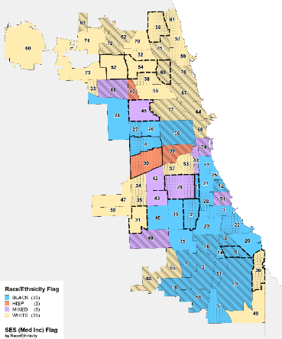
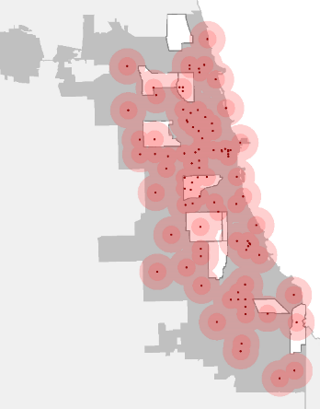
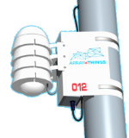
Activity Space and AoT
Responses to surveys may depend on neighborhood environmental conditions (climate, pollution, traffic, noise)
CHART (n=450 in 10 neighborhoods) AoT (n=111)
=

Slide 7
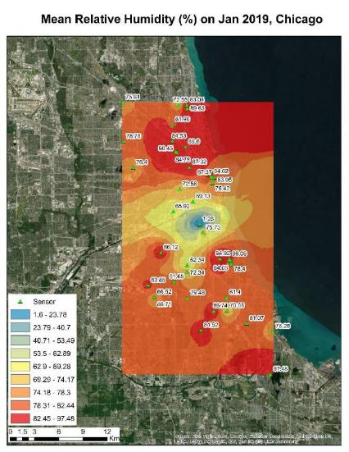
Temperature and Humidity Surfaces

Slide 8
Link Locations Data Across Time, Space

Slide 9
Challenges in Data Linkage
Common examples:
ACS, CPS, or other demographic data
Modeled environmental, pollution information
Other derived or modeled information (e.g, tobacco retailer density)
Each may be available at multiple levels of aggregation:
Census units
ZIP codes
Custom areas
Raster units
Incompatible areal units may not allow for optimal linkage

Slide 10
Challenges in Data Linkage Contd.
Typical use-case demographic data at Census tract, household information at ZIP code level
Many-to-many relationships
Could conduct weighted spatial intersection approach, statistical methods such as calibration (Mulrow et al. 2017)
Ignores temporal nature of ZIP code boundaries
Second use case is associating density information from a raster surface to individuals at address-level
Example is density of tobacco retailer availability (Cantrell et al. 2018)
Accepted to use raster focal statistics, kernel density estimation to model variables at different levels of aggregation
County health outcomes, tract-level demographics, tobacco retailer availability
Limitations related to edge-effects, resolution, MAUP in contextualizing raster unit

Slide 11
Use Case 1- Contextualization at Different Units
The ZIP area intersects 21 Census tracts.
After Mulrow et al. 2017

Slide 12
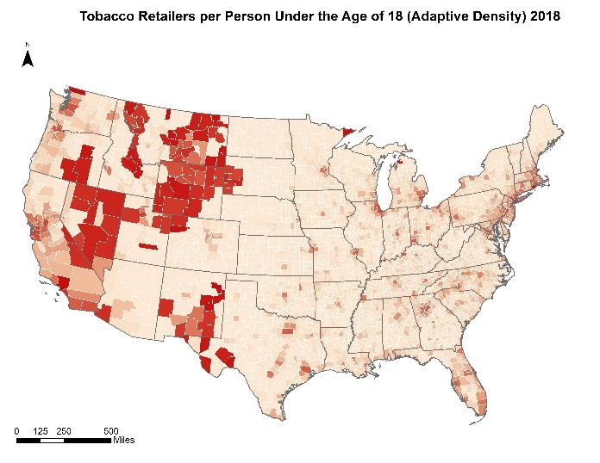
Use Case 2: Linking Raster Densities
0
5.38

Slide 13
Where GSI Can Help
Research in computing, GIS-based infrastructure could help improve blend of statistical small-area methods with high-resolution raster analysis
Contextualization of individual household and social environments
Enhanced computing infrastructure will improve speed and efficacy for large address and associated databases

Slide 14
What GSI Should Do
Engage with government agencies: NIH, CDC, Census, BLS
Professional organizations
Most have educational committees
Training will be key
Students
Faculty
Industry
Government
Key Capabilities:
Share software best practices
Share expertise in dataflow establishment and management
Organization

Slide 15
References
Cantrell, Jennifer, Andrew Anesetti-Rothermel, Haijun Xiao, Morgane Bennett, Peter Herman, and Ned English. Examining Changes in Tobacco Retail Outlet Density over Time and Youth Smoking Behavior. Presented at the American Association of Public Opinion Research Annual Conference, May, 2018, Denver, CO.
Mulrow, Edward, Becki Curtis, Ned English, Yongheng Lin, and Ilana Ventura. Challenges in Linking Demographic Data at Different Geographic Levels. Poster presented at the Joint Statistical Meetings Conference, August, 2017, Baltimore, MD.

Slide 16
Ned English
english-ned@norc.org

